Slide 1
RESPONSIVE WEB DESIGN
&
BOOTSTRAP GRID SYSTEM

Slide 2
Introduction to Responsive Web Design
Responsive Web Design (RWD) – Why?, What?
Bootstrap Grid System – Container, row, column
Multiple Column Layouts – One, Two and Three Layout

Slide 3
What is Responsive Web Design?
Responsive web design makes your web page look good on all devices.
Responsive web design uses only HTML and CSS.
Responsive web design is not a program or a JavaScript.

Slide 4
Bootstrap Grid System
Bootstrap Grid System is a collection of reusable code snippets to create responsive layouts. It is made up of containers, rows, and columns.
It uses a 12 column system for layouting. We can create up to 12 columns across the page.
Container
The purpose of a container is to hold rows and columns.
<div class="container">
</div>

Slide 5
Row
The purpose of a row is to wrap all the columns.
<div class="container">
<div class="row">
</div>
</div>
Column
We should place the columns inside a row and the content inside a column.
We can specify the number of columns our content should occupy in any device. The number of columns we specify should be a number in the range of 1 to 12
.

Slide 6
<div class="container">
<div class="row">
<div class="col-12">
I'm your content inside the grid!
</div>
</div>
</div>
The Bootstrap class names col-* indicates the number of columns you would like to use out of the possible 12 columns per row. For example, col-1, col-5, etc.

Slide 7
<!DOCTYPE html>
<html> <head>
<link rel="stylesheet" href="https://stackpath.bootstrapcdn.com/bootstrap/4.5.2/css/bootstrap.min.css" integrity="sha384-JcKb8q3iqJ61gNV9KGb8thSsNjpSL0n8PARn9HuZOnIxN0hoP+VmmDGMN5t9UJ0Z" crossorigin="anonymous"> <script src="https://code.jquery.com/jquery-3.5.1.slim.min.js" integrity="sha384-DfXdz2htPH0lsSSs5nCTpuj/zy4C+OGpamoFVy38MVBnE+IbbVYUew+OrCXaRkfj" crossorigin="anonymous"></script>
<script src="https://cdn.jsdelivr.net/npm/popper.js@1.16.1/dist/umd/popper.min.js" integrity="sha384-9/reFTGAW83EW2RDu2S0VKaIzap3H66lZH81PoYlFhbGU+6BZp6G7niu735Sk7lN" crossorigin="anonymous"></script>
<script src="https://stackpath.bootstrapcdn.com/bootstrap/4.5.2/js/bootstrap.min.js" integrity="sha384-B4gt1jrGC7Jh4AgTPSdUtOBvfO8shuf57BaghqFfPlYxofvL8/KUEfYiJOMMV+rV" crossorigin="anonymous"></script>
</head>
<body>
<div class="container">
<div class="row">
<div class="col-12">
<h1 class="heading">Taj Mahal</h1>
<p> The Taj Mahal is an ivory-white marble mausoleum on the southern bank of the river Yamuna in the Indian city of Agra. </p>
</div>
</div>
</div> </body></html>

Slide 8
Creating Multiple Column Layouts
The Layout in the below Code Playground is a Two Column Layout. Similarly try out multiple column layouts like One Column Layout, Three Column Layout, etc. in the below Code Playground.
<body>
<div class="container">
<div class="row">
<div class="col-8">
<h1 class="heading">Taj Mahal</h1>
<p> The Taj Mahal is an ivory-white marble mausoleum on the southern bank of the river Yamuna in the Indian city of Agra.</p>
</div>
<div class="col-4">
<h1 class="heading">Mysore Palace</h1>
<p> The Mysore Palace is a historical palace and the royal residence at Mysore in the Indian State of Karnataka. </p>
</div>
</div>
</div>
</body>

Slide 9
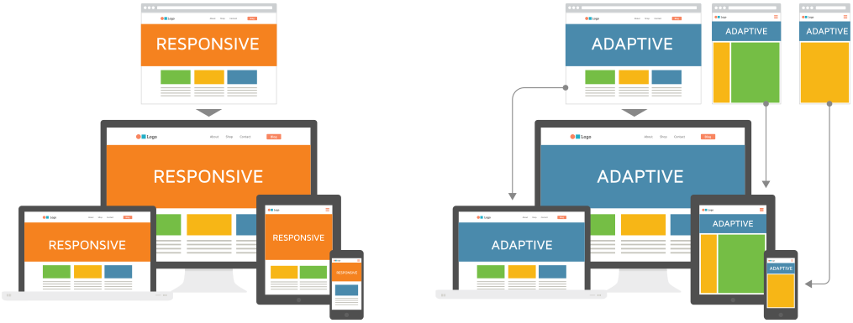
Example for Responsive Web Web Design

Slide 10
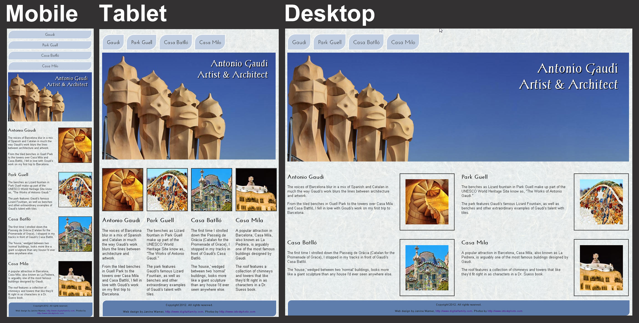

Slide 11
RESPONSIVE WEB DESIGN
Responsive web design is an approach that allows design across various devices (mobile, desktop, tablet, etc.).
Suggests design should respond to the user's behavior based on screen size, platform and orientation.

Slide 13
Responsive Web Design - The Viewport
What is The Viewport?
The viewport is the user's visible area of a web page.
The viewport varies with the device, and will be smaller on a mobile phone than on a computer screen.
Before tablets and mobile phones, web pages were designed only for computer screens, and it was common for web pages to have a static design and a fixed size.
Then, when we started surfing the internet using tablets and mobile phones, fixed size web pages were too large to fit the viewport. To fix this, browsers on those devices scaled down the entire web page to fit the screen.
This was not perfect!! But a quick fix.

Slide 14
Setting The Viewport
HTML5 introduced a method to let web designers take control over the viewport, through the <meta> tag.
You should include the following <meta> viewport element in all your web pages:
<meta name="viewport" content="width=device-width, initial-scale=1.0">
This gives the browser instructions on how to control the page's dimensions and scaling.
The width=device-width part sets the width of the page to follow the screen-width of the device (which will vary depending on the device).
The initial-scale=1.0 part sets the initial zoom level when the page is first loaded by the browser.
Here is an example of a web page without the viewport meta tag, and the same web page with the viewport meta tag:

Slide 15
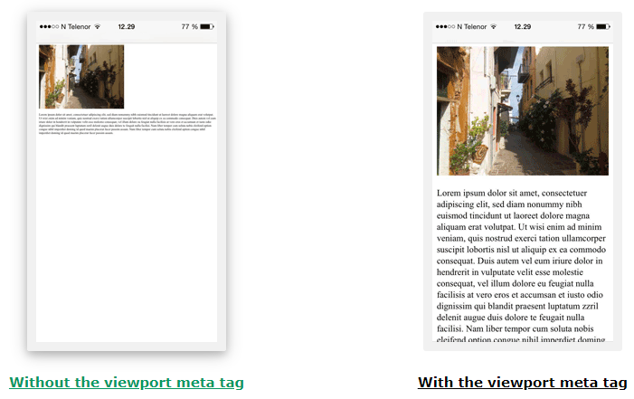

Slide 16
Size Content to The Viewport
Users are used to scroll websites vertically on both desktop and mobile devices - but not horizontally!
So, if the user is forced to scroll horizontally, or zoom out, to see the whole web page it results in a poor user experience.
Some additional rules to follow:
1. Do NOT use large fixed width elements - For example, if an image is displayed at a width wider than the viewport it can cause the viewport to scroll horizontally. Remember to adjust this content to fit within the width of the viewport.
2. Do NOT let the content rely on a particular viewport width to render well - Since screen dimensions and width in CSS pixels vary widely between devices, content should not rely on a particular viewport width to render well.
3. Use CSS media queries to apply different styling for small and large screens - Setting large absolute CSS widths for page elements will cause the element to be too wide for the viewport on a smaller device. Instead, consider using relative width values, such as width: 100%. Also, be careful of using large absolute positioning values. It may cause the element to fall outside the viewport on small devices.

Slide 17
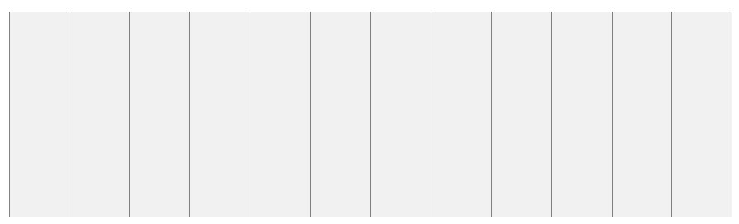
Responsive Web Design - Grid-View
What is a Grid-View?
Many web pages are based on a grid-view, which means that the page is divided into columns:

Slide 18
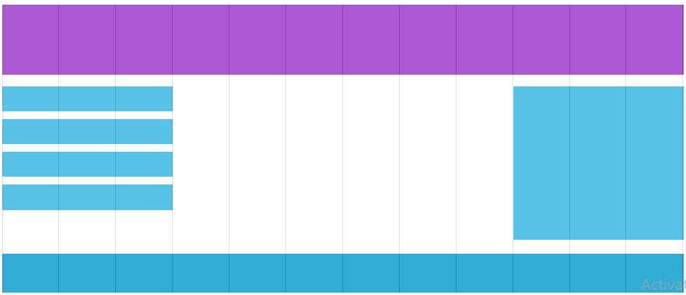
Using a grid-view is very helpful when designing web pages. It makes it easier to place elements on the page.
A responsive grid-view often has 12 columns, and has a total width of 100%, and will shrink and expand as you resize the browser window.

Slide 19
Building a Responsive Grid-View
Lets start building a responsive grid-view.
First ensure that all HTML elements have the box-sizing property set to border-box. This makes sure that the padding and border are included in the total width and height of the elements.
Add the following code in your CSS:
* { box-sizing: border-box; }

Slide 20
<!DOCTYPE html>
<html>
<head>
<meta name="viewport" content="width=device-width, initial-scale=1.0">
<style>
* {
box-sizing: border-box;
}
.header {
border: 1px solid red;
padding: 15px;
}
.menu {
width: 25%;
float: left;
padding: 15px;
border: 1px solid red;
}
.main {
width: 75%;
float: left;
padding: 15px;
border: 1px solid red;
}
</style>
</head>

Slide 21
<body>
<div class="header">
<h1>Chania</h1>
</div>
<div class="menu">
<ul>
<li>The Flight</li>
<li>The City</li>
<li>The Island</li>
<li>The Food</li>
</ul>
</div>
<div class="main">
<h1>The City</h1>
<p>Chania is the capital of the Chania region on the island of Crete. The city can be divided in two parts, the old town and the modern city.</p>
<p>Resize the browser window to see how the content respond to the resizing.</p>
</div>
</body>
</html>

Slide 22
The example above is fine if the web page only contains two columns.
However, we want to use a responsive grid-view with 12 columns, to have more control over the web page.
First we must calculate the percentage for one column: 100% / 12 columns = 8.33%.
Then we make one class for each of the 12 columns, class="col-" and a number defining how many columns the section should span:

Slide 23
<!DOCTYPE html>
<html>
<head>
<meta name="viewport" content="width=device-width, initial-scale=1.0">
<style>
* {
box-sizing: border-box;
}
.header {
border: 1px solid red;
padding: 15px;
}
.row::after {
content: "";
clear: both;
display: table;
}
[class*="col-"] {
float: left;
padding: 15px;
border: 1px solid red;
}
.col-1 {width: 8.33%;}
.col-2 {width: 16.66%;}
.col-3 {width: 25%;}
.col-4 {width: 33.33%;}
.col-5 {width: 41.66%;}
.col-6 {width: 50%;}
.col-7 {width: 58.33%;}
.col-8 {width: 66.66%;}
.col-9 {width: 75%;}
.col-10 {width: 83.33%;}
.col-11 {width: 91.66%;}
.col-12 {width: 100%;}
</style>
</head>
<body>

Slide 24
<div class="header">
<h1>Chania</h1>
</div>
<div class="row">
<div class="col-3">
<ul>
<li>The Flight</li>
<li>The City</li>
<li>The Island</li>
<li>The Food</li>
</ul>
</div>
<div class="col-9">
<h1>The City</h1>
<p>Chania is the capital of the Chania region on the island of Crete. The city can be divided in two parts, the old town and the modern city.</p>
<p>Resize the browser window to see how the content respond to the resizing.</p>
</div>
</div>
</body>
</html>

Slide 25
[class*="col-"] { float: left; padding: 15px; border: 1px solid red; }
Each row should be wrapped in a <div>. The number of columns inside a row should always add up to 12:
<div class="row"> <div class="col-3">...</div> <!-- 25% --> <div class="col-9">...</div> <!-- 75% --> </div>
The columns inside a row are all floating to the left, and are therefore taken out of the flow of the page, and other elements will be placed as if the columns do not exist. To prevent this, we will add a style that clears the flow:

Slide 26
.row::after { content: ""; clear: both; display: table; }
We also want to add some styles and colors to make it look better:

Slide 27
<!DOCTYPE html>
<html>
<head>
<meta name="viewport" content="width=device-width, initial-scale=1.0">
<style>
* {
box-sizing: border-box;
}
.row::after {
content: "";
clear: both;
display: table;
}
[class*="col-"] {
float: left;
padding: 15px;
}
.col-1 {width: 8.33%;}
.col-2 {width: 16.66%;}
.col-3 {width: 25%;}
.col-4 {width: 33.33%;}
.col-5 {width: 41.66%;}
.col-6 {width: 50%;}
.col-7 {width: 58.33%;}
.col-8 {width: 66.66%;}
.col-9 {width: 75%;}
.col-10 {width: 83.33%;}
.col-11 {width: 91.66%;}
.col-12 {width: 100%;}

Slide 28
html {
font-family: "Lucida Sans", sans-serif;
}
.header {
background-color: #9933cc;
color: #ffffff;
padding: 15px;
}
.menu ul {
list-style-type: none;
margin: 0;
padding: 0;
}
.menu li {
padding: 8px;
margin-bottom: 7px;
background-color: #33b5e5;
color: #ffffff;
box-shadow: 0 1px 3px rgba(0,0,0,0.12), 0 1px 2px rgba(0,0,0,0.24);
}
.menu li:hover {
background-color: #0099cc;
}
</style>
</head>

Slide 29
<body>
<div class="header">
<h1>Chania</h1>
</div>
<div class="row">
<div class="col-3 menu">
<ul>
<li>The Flight</li>
<li>The City</li>
<li>The Island</li>
<li>The Food</li>
</ul>
</div>
<div class="col-9">
<h1>The City</h1>
<p>Chania is the capital of the Chania region on the island of Crete. The city can be divided in two parts, the old town and the modern city.</p>
<p>Resize the browser window to see how the content respond to the resizing.</p>
</div>
</div>
</body>
</html>

Slide 30

How to build Responsive Web Design
Bootstrap Grid System

Slide 31
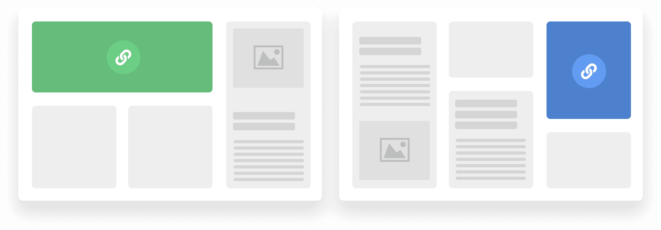
Grid System
A Collection of reusable code snippets to create Responsive Layouts

Slide 32
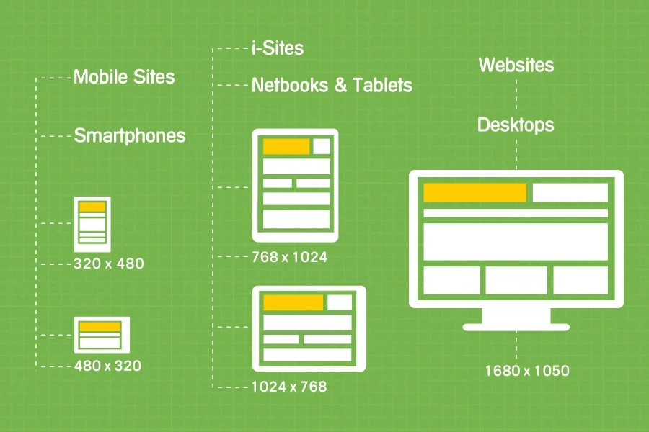
Wide Variety if Sizes

Slide 33
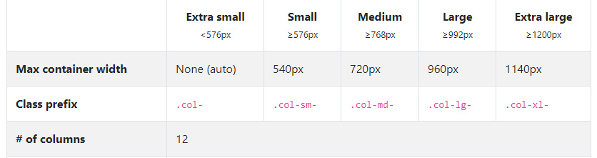
Five Responsive Tigers
Responsive Breakpoints

Slide 34
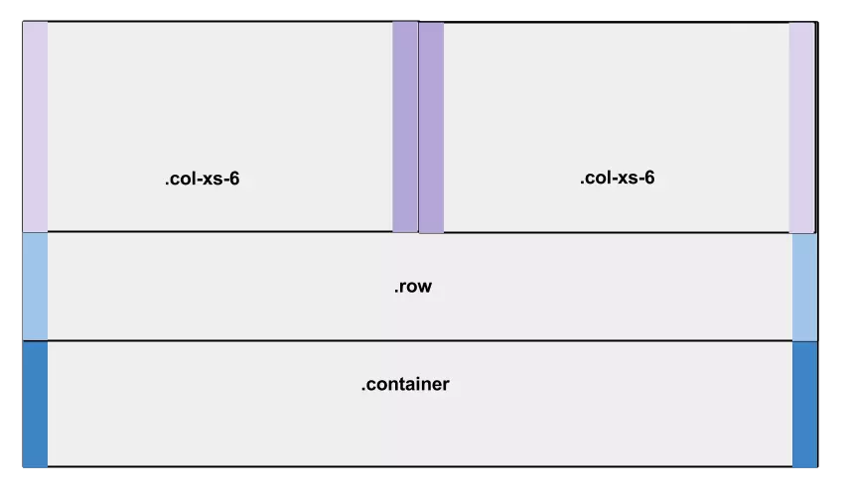
How it Works
Bootstrap Grid system is made up of three things :
Container – Rows & Columns
Rows - Columns
Columns – 12 Column system for layout

Slide 35
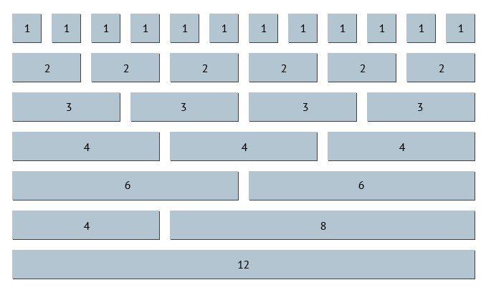
Different & Specifying Column System

Slide 36
How to create a Layout using Bootstrap Grid System ?
<div class=”container”>
<div class=”rows”>
<div class=”col-lg-6”>
....
</div>
<div class=”col-lg-6”>
....
</div>
</div>
</div>

Slide 37
<style>
.item1 { grid-area: header; }
.item2 { grid-area: menu; }
.item3 { grid-area: main; }
.item4 { grid-area: right; }
.item5 { grid-area: footer; }
.grid-container {
display: grid;
grid-template-areas:
'header header header header header header'
'menu main main main right right'
'menu footer footer footer footer footer';
gap: 10px;
background-color: #2196F3;
padding: 10px;
}
.grid-container > div {
background-color: rgba(255, 255, 255, 0.8);
text-align: center;
padding: 20px 0;
font-size: 30px;
}
</style>
</head>
CSS Grid Layout Module

Slide 38
<body>
<h1>Grid Layout</h1>
<p>This grid layout contains six columns and three rows:</p>
<div class="grid-container">
<div class="item1">Header</div>
<div class="item2">Menu</div>
<div class="item3">Main</div>
<div class="item4">Right</div>
<div class="item5">Footer</div>
</div>
</body>
</html>

Slide 39
Grid Layout
The CSS Grid Layout Module offers a grid-based layout system, with rows and columns, making it easier to design web pages without having to use floats and positioning.
Grid Elements
A grid layout consists of a parent element, with one or more child elements.

Slide 40
<!DOCTYPE html>
<html>
<head>
<style>
.grid-container {
display: grid;
grid-template-columns: auto auto auto;
background-color: #2196F3;
padding: 10px;
}
.grid-item {
background-color: rgba(255, 255, 255, 0.8);
border: 1px solid rgba(0, 0, 0, 0.8);
padding: 20px;
font-size: 30px;
text-align: center;
}
</style>
</head>

Slide 41
<body>
<h1>Grid Elements</h1>
<p>A Grid Layout must have a parent element with the <em>display</em> property set to <em>grid</em> or <em>inline-grid</em>.</p>
<p>Direct child element(s) of the grid container automatically becomes grid items.</p>
<div class="grid-container">
<div class="grid-item">1</div>
<div class="grid-item">2</div>
<div class="grid-item">3</div>
<div class="grid-item">4</div>
<div class="grid-item">5</div>
<div class="grid-item">6</div>
<div class="grid-item">7</div>
<div class="grid-item">8</div>
<div class="grid-item">9</div>
</div>
</body>
</html>

Slide 42
Display Property
An HTML element becomes a grid container when its display property is set to grid or inline-grid.
.grid-container { display: grid; }
.grid-container { display: inline-grid; }

Slide 43
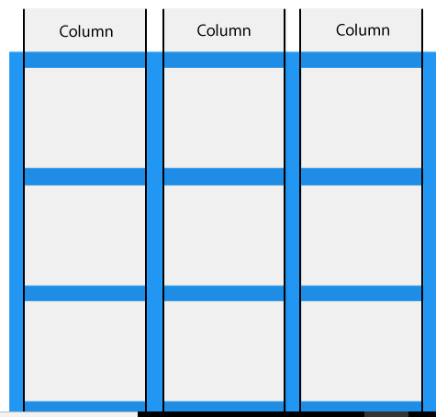
Grid Columns
The vertical lines of grid items are called columns.

Slide 44
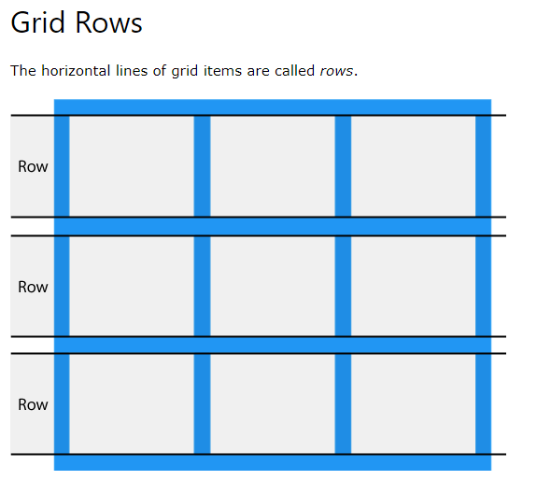

Slide 45
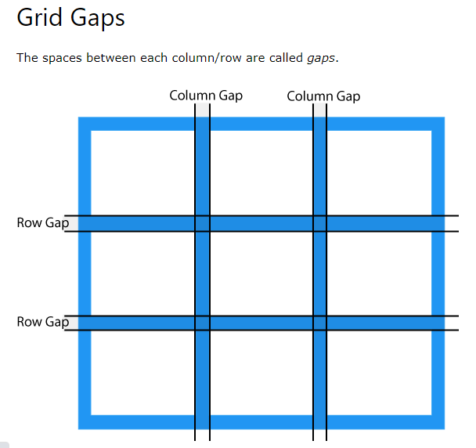
You can adjust the gap size by using one of the following properties:
column-gap
row-gap
gap

Slide 46
<!DOCTYPE html>
<html>
<head>
<style>
.grid-container {
display: grid;
column-gap: 50px;
grid-template-columns: auto auto auto;
background-color: #2196F3;
padding: 10px;
}
.grid-item {
background-color: rgba(255, 255, 255, 0.8);
border: 1px solid rgba(0, 0, 0, 0.8);
padding: 20px;
font-size: 30px;
text-align: center;
}
</style>
</head>

Slide 47
<body>
<h1>The column-gap Property</h1>
<p>Use the <em>column-gap</em> property to adjust the space between the columns:</p>
<div class="grid-container">
<div class="grid-item">1</div>
<div class="grid-item">2</div>
<div class="grid-item">3</div>
<div class="grid-item">4</div>
<div class="grid-item">5</div>
<div class="grid-item">6</div>
<div class="grid-item">7</div>
<div class="grid-item">8</div>
<div class="grid-item">9</div>
</div>
</body>
</html>

Slide 48
.grid-container { display: grid; row-gap: 50px; }
.grid-container { display: grid; gap: 50px 100px; }

Slide 49
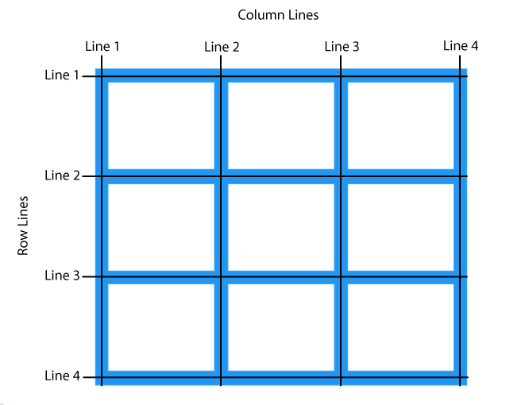
Grid Lines
The lines between columns are called column lines.
The lines between rows are called row lines.

Slide 50
<!DOCTYPE html>
<html>
<head>
<style>
.grid-container {
display: grid;
grid-template-columns: auto auto auto;
gap: 10px;
background-color: #2196F3;
padding: 10px;
}
.grid-container > div {
background-color: rgba(255, 255, 255, 0.8);
text-align: center;
padding: 20px 0;
font-size: 30px;
}
.item1 {
grid-column-start: 1;
grid-column-end: 3;
}
</style>
</head>
.item1 { grid-row-start: 1; grid-row-end: 3; }

Slide 51
<body>
<h1>Grid Lines</h1>
<div class="grid-container">
<div class="item1">1</div>
<div class="item2">2</div>
<div class="item3">3</div>
<div class="item4">4</div>
<div class="item5">5</div>
<div class="item6">6</div>
<div class="item7">7</div>
<div class="item8">8</div>
</div>
<p>You can refer to line numbers when placing grid items.</p>
</body>
</html>

Slide 52
CSS Grid Container
<!DOCTYPE html>
<html>
<head>
<style>
.grid-container {
display: grid;
grid-template-columns: auto auto auto auto;
gap: 10px;
background-color: #2196F3;
padding: 10px;
}
.grid-container > div {
background-color: rgba(255, 255, 255, 0.8);
border: 1px solid black;
text-align: center;
font-size: 30px;
}
</style>
</head>

Slide 53
<body>
<h1>Grid Container</h1>
<p>A Grid Container consists of grid items arranged in columns and rows</p>
<div class="grid-container">
<div>1</div>
<div>2</div>
<div>3</div>
<div>4</div>
<div>5</div>
<div>6</div>
<div>7</div>
<div>8</div>
</div>
<p>Direct child elements(s) of the grid container automatically becomes grid items.</p>
</body>
</html>

Slide 54
Grid Container
To make an HTML element behave as a grid container, you have to set the display property to grid or inline-grid.
Grid containers consist of grid items, placed inside columns and rows.
The grid-template-columns Property
The grid-template-columns property defines the number of columns in your grid layout, and it can define the width of each column.
The value is a space-separated-list, where each value defines the width of the respective column.
If you want your grid layout to contain 4 columns, specify the width of the 4 columns, or "auto" if all columns should have the same width.

Slide 55
<!DOCTYPE html>
<html>
<head>
<style>
.grid-container {
display: grid;
grid-template-columns: auto auto auto auto;
gap: 10px;
background-color: #2196F3;
padding: 10px;
}
.grid-container > div {
background-color: rgba(255, 255, 255, 0.8);
text-align: center;
padding: 20px 0;
font-size: 30px;
}
</style>
</head>

Slide 56
<body>
<h1>The grid-template-columns Property</h1>
<p>You can use the <em>grid-template-columns</em> property to specify the number of columns in your grid layout.</p>
<div class="grid-container">
<div>1</div>
<div>2</div>
<div>3</div>
<div>4</div>
<div>5</div>
<div>6</div>
<div>7</div>
<div>8</div>
</div>
</body>
</html>

Slide 57
The grid-template-columns property can also be used to specify the size (width) of the columns.
.grid-container { display: grid; grid-template-columns: 80px 200px auto 40px; }
The grid-template-rows Property
The grid-template-rows property defines the height of each row.

Slide 58
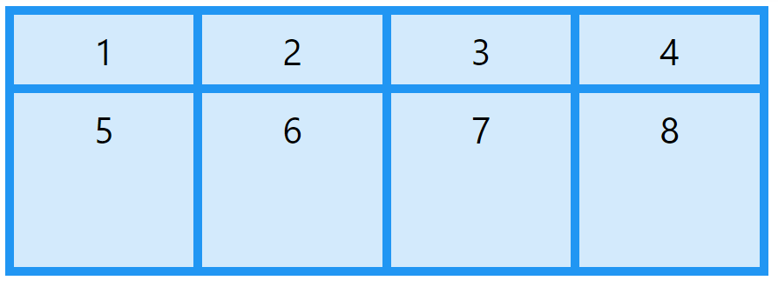
.grid-container { display: grid; grid-template-rows: 80px 200px; }

Slide 59
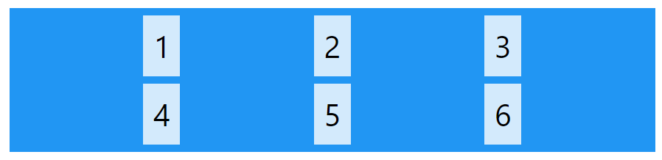
The justify-content Property
The justify-content property is used to align the whole grid inside the container.

Slide 60
<!DOCTYPE html>
<html>
<head>
<style>
.grid-container {
display: grid;
justify-content: space-evenly;
grid-template-columns: 50px 50px 50px; /*Make the grid smaller than the container*/
gap: 10px;
background-color: #2196F3;
padding: 10px;
}
.grid-container > div {
background-color: rgba(255, 255, 255, 0.8);
text-align: center;
padding: 20px 0;
font-size: 30px;
}
</style>
</head>

Slide 61
<body>
<h1>The justify-content Property</h1>
<p>Use the <em>justify-content</em> property to align the grid inside the container.</p>
<p>The value "space-evenly" will give the columns equal amount of space between, and around them:</p>
<div class="grid-container">
<div>1</div>
<div>2</div>
<div>3</div>
<div>4</div>
<div>5</div>
<div>6</div>
</div>
</body>
</html>

Slide 62
.grid-container { display: grid; justify-content: space-around; }
.grid-container { display: grid; justify-content: center; }
.grid-container { display: grid; justify-content: space-between; }
.grid-container { display: grid; justify-content: start; }
.grid-container { display: grid; justify-content: end; }

Slide 63
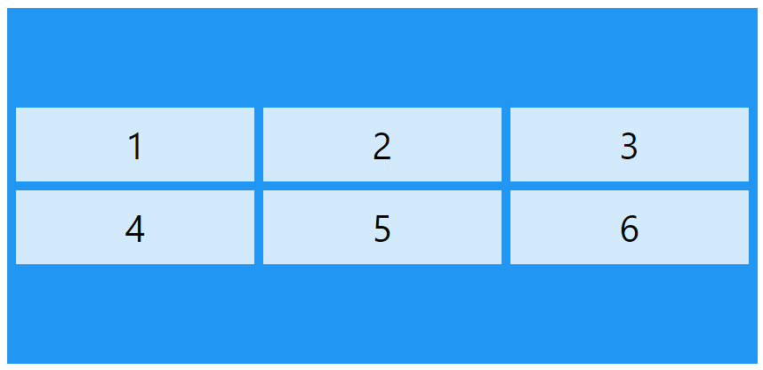
The align-content Property
The align-content property is used to vertically align the whole grid inside the container.

Slide 64
.grid-container { display: grid; height: 400px; align-content: center; }
.grid-container { display: grid; height: 400px; align-content: space-evenly; }
.grid-container { display: grid; height: 400px; align-content: space-around; }
.grid-container { display: grid; height: 400px; align-content: space-between; }
.grid-container { display: grid; height: 400px; align-content: start; }
.grid-container { display: grid; height: 400px; align-content: end; }

Slide 65
CSS Grid Item
<!DOCTYPE html>
<html>
<head>
<style>
.grid-container {
display: grid;
gap: 10px;
background-color: #2196F3;
padding: 10px;
}
.grid-item {
background-color: rgba(255, 255, 255, 0.8);
text-align: center;
padding: 20px;
font-size: 30px;
}
.item1 {
grid-column: 1 / span 2;
grid-row: 1;
}

Slide 66
.item2 {
grid-column: 3;
grid-row: 1 / span 2;
}
.item5 {
grid-column: 1 / span 3;
grid-row: 3;
}
</style>
</head>
<body>
<h1>A Five Items Grid Layout</h1>
<div class="grid-container">
<div class="grid-item item1">1</div>
<div class="grid-item item2">2</div>
<div class="grid-item item3">3</div>
<div class="grid-item item4">4</div>
<div class="grid-item item5">5</div>
</div>

Slide 67
<p>Direct child elements(s) of the grid container automatically becomes grid items.</p>
<p>Item 1, 2, and 5 are set to span multiple columns or rows.</p>
</body>
</html>
Child Elements (Items)
A grid container contains grid items.
By default, a container has one grid item for each column, in each row, but you can style the grid items so that they will span multiple columns and/or rows.

Slide 68
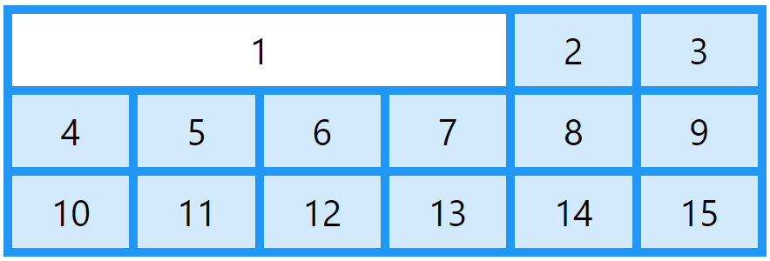
The grid-column Property:
The grid-column property defines on which column(s) to place an item.
You define where the item will start, and where the item will end.

Slide 69
<!DOCTYPE html>
<html>
<head>
<style>
.grid-container {
display: grid;
grid-template-columns: auto auto auto auto auto auto;
gap: 10px;
background-color: #2196F3;
padding: 10px;
}
.grid-container > div {
background-color: rgba(255, 255, 255, 0.8);
text-align: center;
padding: 20px 0;
font-size: 30px;
}
.item1 {
grid-column: 1 / 5;
}
</style>
</head>

Slide 70
<body>
<h1>The grid-column Property</h1>
<p>Use the <em>grid-column</em> property to specify where to place an item.</p>
<p>Item1 will start on column 1 and end before column 5:</p>
<div class="grid-container">
<div class="item1">1</div>
<div class="item2">2</div>
<div class="item3">3</div>
<div class="item4">4</div>
<div class="item5">5</div>
<div class="item6">6</div>
<div class="item7">7</div>
<div class="item8">8</div>
<div class="item9">9</div>
<div class="item10">10</div>
<div class="item11">11</div>
<div class="item12">12</div>
<div class="item13">13</div>
<div class="item14">14</div>
<div class="item15">15</div>
</div>
</body>
</html>

Slide 71
.item1 {
grid-column: 1 / span 3;
}
.item2 {
grid-column: 2 / span 3;
}

Slide 72
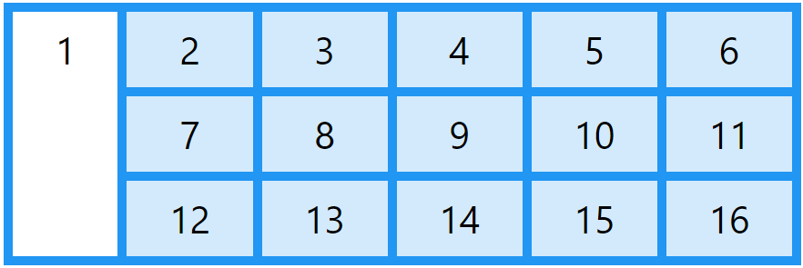
The grid-row Property:
The grid-row property defines on which row to place an item.
You define where the item will start, and where the item will end.

Slide 73
<html>
<head>
<style>
.grid-container {
display: grid;
grid-template-columns: auto auto auto auto auto auto;
gap: 10px;
background-color: #2196F3;
padding: 10px;
}
.grid-container > div {
background-color: rgba(255, 255, 255, 0.8);
text-align: center;
padding: 20px 0;
font-size: 30px;
}
.item1 {
grid-row: 1 / 4;
}
</style>
</head>

Slide 74
<body>
<h1>The grid-row Property</h1>
<p>Use the <em>grid-row</em> property to specify where to place an item.</p>
<p>Item1 will start on row-line 1 and end on row-line 4:</p>
<div class="grid-container">
<div class="item1">1</div>
<div class="item2">2</div>
<div class="item3">3</div>
<div class="item4">4</div>
<div class="item5">5</div>
<div class="item6">6</div>
<div class="item7">7</div>
<div class="item8">8</div>
<div class="item9">9</div>
<div class="item10">10</div>
<div class="item11">11</div>
<div class="item12">12</div>
<div class="item13">13</div>
<div class="item14">14</div>
<div class="item15">15</div>
<div class="item16">16</div>
</div>
</body>
</html>

Slide 75
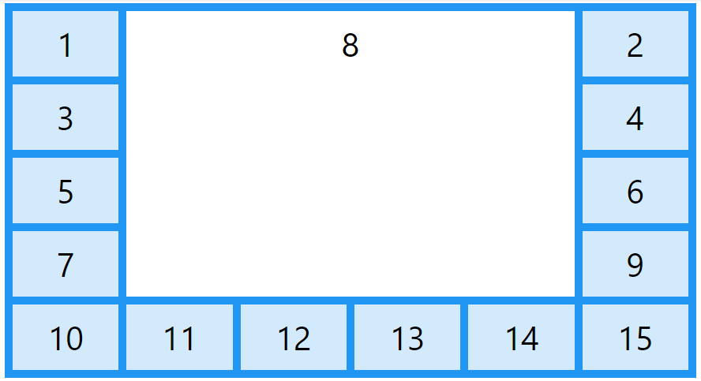
The grid-area Property
The grid-area property can be used as a shorthand property for the grid-row-start, grid-column-start, grid-row-end and the grid-column-end properties.

Slide 76
<!DOCTYPE html>
<html>
<head>
<style>
.grid-container {
display: grid;
grid-template-columns: auto auto auto auto auto auto;
gap: 10px;
background-color: #2196F3;
padding: 10px;
}
.grid-container > div {
background-color: rgba(255, 255, 255, 0.8);
text-align: center;
padding: 20px 0;
font-size: 30px;
}
.item8 {
grid-area: 1 / 2 / 5 / 6;
}
</style>
</head>

Slide 77
<body>
<h1>The grid-area Property</h1>
<p>You can use the <em>grid-area</em> property to specify where to place an item.</p>
<p>The syntax is:</p>
<p>grid-row-start / grid-column-start / grid-row-end / grid-column-end.</p>
<p>Item8 will start on row-line 1 and column-line 2, and end on row-line 5 column-line 6:</p>
<div class="grid-container">
<div class="item1">1</div>
<div class="item2">2</div>
<div class="item3">3</div>
<div class="item4">4</div>
<div class="item5">5</div>
<div class="item6">6</div>
<div class="item7">7</div>
<div class="item8">8</div>
<div class="item9">9</div>
<div class="item10">10</div>
<div class="item11">11</div>
<div class="item12">12</div>
<div class="item13">13</div>
<div class="item14">14</div>
<div class="item15">15</div>
</div>
</body>
</html>

Slide 78
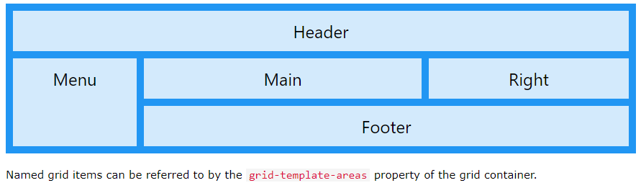
Naming Grid Items
The grid-area property can also be used to assign names to grid items.

Slide 79
<!DOCTYPE html>
<html>
<head>
<style>
.item1 {
grid-area: myArea;
}
.grid-container {
display: grid;
grid-template-areas: 'myArea myArea myArea myArea myArea';
gap: 10px;
background-color: #2196F3;
padding: 10px;
}
.grid-container > div {
background-color: rgba(255, 255, 255, 0.8);
text-align: center;
padding: 20px 0;
font-size: 30px;
}
</style>
</head>

Slide 80
<body>
<h1>The grid-area Property</h1>
<p>You can use the <em>grid-area</em> property to name grid items.</p>
<p>You can refer to the name when you set up the grid layout, by using the <em>grid-template-areas</em> property on the grid container.</p>
<p>Item1, is called "myArea" and will take up the place of all five columns:</p>
<div class="grid-container">
<div class="item1">1</div>
<div class="item2">2</div>
<div class="item3">3</div>
<div class="item4">4</div>
<div class="item5">5</div>
<div class="item6">6</div>
</div>
</body>
</html>

Slide 81
Responsive Web Design - Media Queries
What is a Media Query?
Media query is a CSS technique introduced in CSS3.
It uses the @media rule to include a block of CSS properties only if a certain condition is true.

Slide 82
<!DOCTYPE html>
<html>
<head>
<meta name="viewport" content="width=device-width, initial-scale=1.0">
<style>
body {
background-color: lightgreen;
}
@media only screen and (max-width: 600px) {
body {
background-color: lightblue;
}
}
</style>
</head>
<body>
<p>Resize the browser window. When the width of this document is 600 pixels or less, the background-color is "lightblue", otherwise it is "lightgreen".</p>
</body>
</html>

Slide 83
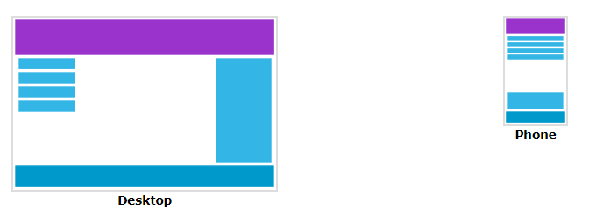
Add a Breakpoint
Earlier in this tutorial we made a web page with rows and columns, and it was responsive, but it did not look good on a small screen.
Media queries can help with that. We can add a breakpoint where certain parts of the design will behave differently on each side of the breakpoint.

Slide 84
<!DOCTYPE html>
<html>
<head>
<meta name="viewport" content="width=device-width, initial-scale=1.0">
<style>
* {
box-sizing: border-box;
}
.row::after {
content: "";
clear: both;
display: block;
}
[class*="col-"] {
float: left;
padding: 15px;
}
html {
font-family: "Lucida Sans", sans-serif;
}

Slide 85
.header {
background-color: #9933cc;
color: #ffffff;
padding: 15px;
}
.menu ul {
list-style-type: none;
margin: 0;
padding: 0;
}
.menu li {
padding: 8px;
margin-bottom: 7px;
background-color: #33b5e5;
color: #ffffff;
box-shadow: 0 1px 3px rgba(0,0,0,0.12), 0 1px 2px rgba(0,0,0,0.24);
}
.menu li:hover {
background-color: #0099cc;
}

Slide 86
.aside {
background-color: #33b5e5;
padding: 15px;
color: #ffffff;
text-align: center;
font-size: 14px;
box-shadow: 0 1px 3px rgba(0,0,0,0.12), 0 1px 2px rgba(0,0,0,0.24);
}
.footer {
background-color: #0099cc;
color: #ffffff;
text-align: center;
font-size: 12px;
padding: 15px;
}

Slide 87
/* For desktop: */
.col-1 {width: 8.33%;}
.col-2 {width: 16.66%;}
.col-3 {width: 25%;}
.col-4 {width: 33.33%;}
.col-5 {width: 41.66%;}
.col-6 {width: 50%;}
.col-7 {width: 58.33%;}
.col-8 {width: 66.66%;}
.col-9 {width: 75%;}
.col-10 {width: 83.33%;}
.col-11 {width: 91.66%;}
.col-12 {width: 100%;}
@media only screen and (max-width: 768px) {
/* For mobile phones: */
[class*="col-"] {
width: 100%;
}
}
</style>
</head>

Slide 88
<body>
<div class="header">
<h1>Chania</h1>
</div>
<div class="row">
<div class="col-3 menu">
<ul>
<li>The Flight</li>
<li>The City</li>
<li>The Island</li>
<li>The Food</li>
</ul>
</div>
<div class="col-6">
<h1>The City</h1>
<p>Chania is the capital of the Chania region on the island of Crete. The city can be divided in two parts, the old town and the modern city.</p>
</div>

Slide 89
<div class="col-3 right">
<div class="aside">
<h2>What?</h2>
<p>Chania is a city on the island of Crete.</p>
<h2>Where?</h2>
<p>Crete is a Greek island in the Mediterranean Sea.</p>
<h2>How?</h2>
<p>You can reach Chania airport from all over Europe.</p>
</div>
</div>
</div>
<div class="footer">
<p>Resize the browser window to see how the content respond to the resizing.</p>
</div>
</body>
</html>

Slide 90
Always Design for Mobile First
Mobile First means designing for mobile before designing for desktop or any other device (This will make the page display faster on smaller devices).
This means that we must make some changes in our CSS.
Instead of changing styles when the width gets smaller than 768px, we should change the design when the width gets larger than 768px. This will make our design Mobile First:

Slide 91
<!DOCTYPE html>
<html>
<head>
<meta name="viewport" content="width=device-width, initial-scale=1.0">
<style>
* {
box-sizing: border-box;
}
.row::after {
content: "";
clear: both;
display: table;
}
[class*="col-"] {
float: left;
padding: 15px;
}
html {
font-family: "Lucida Sans", sans-serif;
}

Slide 92
.header {
background-color: #9933cc;
color: #ffffff;
padding: 15px;
}
.menu ul {
list-style-type: none;
margin: 0;
padding: 0;
}
.menu li {
padding: 8px;
margin-bottom: 7px;
background-color: #33b5e5;
color: #ffffff;
box-shadow: 0 1px 3px rgba(0,0,0,0.12), 0 1px 2px rgba(0,0,0,0.24);
}
.menu li:hover {
background-color: #0099cc;
}

Slide 93
.aside {
background-color: #33b5e5;
padding: 15px;
color: #ffffff;
text-align: center;
font-size: 14px;
box-shadow: 0 1px 3px rgba(0,0,0,0.12), 0 1px 2px rgba(0,0,0,0.24);
}
.footer {
background-color: #0099cc;
color: #ffffff;
text-align: center;
font-size: 12px;
padding: 15px;
}
/* For mobile phones: */
[class*="col-"] {
width: 100%;
}

Slide 94
@media only screen and (min-width: 768px) {
/* For desktop: */
.col-1 {width: 8.33%;}
.col-2 {width: 16.66%;}
.col-3 {width: 25%;}
.col-4 {width: 33.33%;}
.col-5 {width: 41.66%;}
.col-6 {width: 50%;}
.col-7 {width: 58.33%;}
.col-8 {width: 66.66%;}
.col-9 {width: 75%;}
.col-10 {width: 83.33%;}
.col-11 {width: 91.66%;}
.col-12 {width: 100%;}
}
</style>
</head>

Slide 95
<body>
<div class="header">
<h1>Chania</h1>
</div>
<div class="row">
<div class="col-3 menu">
<ul>
<li>The Flight</li>
<li>The City</li>
<li>The Island</li>
<li>The Food</li>
</ul>
</div>
<div class="col-6">
<h1>The City</h1>
<p>Chania is the capital of the Chania region on the island of Crete. The city can be divided in two parts, the old town and the modern city.</p>
</div>

Slide 96
<div class="col-3 right">
<div class="aside">
<h2>What?</h2>
<p>Chania is a city on the island of Crete.</p>
<h2>Where?</h2>
<p>Crete is a Greek island in the Mediterranean Sea.</p>
<h2>How?</h2>
<p>You can reach Chania airport from all over Europe.</p>
</div>
</div>
</div>
<div class="footer">
<p>Resize the browser window to see how the content respond to the resizing.</p>
</div>
</body>
</html>

Slide 97
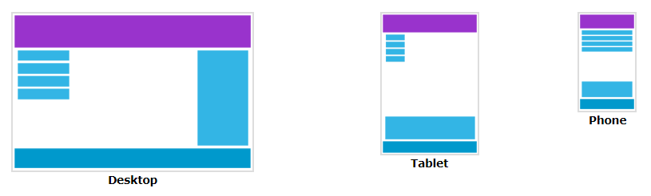
Another Breakpoint
You can add as many breakpoints as you like.
We will also insert a breakpoint between tablets and mobile phones.
We do this by adding one more media query (at 600px), and a set of new classes for devices larger than 600px (but smaller than 768px):

Slide 98
/* For mobile phones: */ [class*="col-"] { width: 100%; } @media only screen and (min-width: 600px) { /* For tablets: */ .col-s-1 {width: 8.33%;} .col-s-2 {width: 16.66%;} .col-s-3 {width: 25%;} .col-s-4 {width: 33.33%;} .col-s-5 {width: 41.66%;} .col-s-6 {width: 50%;} .col-s-7 {width: 58.33%;} .col-s-8 {width: 66.66%;} .col-s-9 {width: 75%;} .col-s-10 {width: 83.33%;} .col-s-11 {width: 91.66%;} .col-s-12 {width: 100%;} }

Slide 99
@media only screen and (min-width: 768px) { /* For desktop: */ .col-1 {width: 8.33%;} .col-2 {width: 16.66%;} .col-3 {width: 25%;} .col-4 {width: 33.33%;} .col-5 {width: 41.66%;} .col-6 {width: 50%;} .col-7 {width: 58.33%;} .col-8 {width: 66.66%;} .col-9 {width: 75%;} .col-10 {width: 83.33%;} .col-11 {width: 91.66%;} .col-12 {width: 100%;} }

Slide 100
<!DOCTYPE html>
<html>
<head>
<meta name="viewport" content="width=device-width, initial-scale=1.0">
<style>
* {
box-sizing: border-box;
}
.row::after {
content: "";
clear: both;
display: table;
}
[class*="col-"] {
float: left;
padding: 15px;
}
html {
font-family: "Lucida Sans", sans-serif;
}

Slide 101
.header {
background-color: #9933cc;
color: #ffffff;
padding: 15px;
}
.menu ul {
list-style-type: none;
margin: 0;
padding: 0;
}
.menu li {
padding: 8px;
margin-bottom: 7px;
background-color: #33b5e5;
color: #ffffff;
box-shadow: 0 1px 3px rgba(0,0,0,0.12), 0 1px 2px rgba(0,0,0,0.24);
}
.menu li:hover {
background-color: #0099cc;
}

Slide 102
.aside {
background-color: #33b5e5;
padding: 15px;
color: #ffffff;
text-align: center;
font-size: 14px;
box-shadow: 0 1px 3px rgba(0,0,0,0.12), 0 1px 2px rgba(0,0,0,0.24);
}
.footer {
background-color: #0099cc;
color: #ffffff;
text-align: center;
font-size: 12px;
padding: 15px;
}
/* For mobile phones: */
[class*="col-"] {
width: 100%;
}

Slide 103
@media only screen and (min-width: 600px) {
/* For tablets: */
.col-s-1 {width: 8.33%;}
.col-s-2 {width: 16.66%;}
.col-s-3 {width: 25%;}
.col-s-4 {width: 33.33%;}
.col-s-5 {width: 41.66%;}
.col-s-6 {width: 50%;}
.col-s-7 {width: 58.33%;}
.col-s-8 {width: 66.66%;}
.col-s-9 {width: 75%;}
.col-s-10 {width: 83.33%;}
.col-s-11 {width: 91.66%;}
.col-s-12 {width: 100%;}
}
@media only screen and (min-width: 768px) {
/* For desktop: */
.col-1 {width: 8.33%;}
.col-2 {width: 16.66%;}
.col-3 {width: 25%;}
.col-4 {width: 33.33%;}
.col-5 {width: 41.66%;}
.col-6 {width: 50%;}
.col-7 {width: 58.33%;}
.col-8 {width: 66.66%;}
.col-9 {width: 75%;}
.col-10 {width: 83.33%;}
.col-11 {width: 91.66%;}
.col-12 {width: 100%;}
}
</style>
</head>

Slide 104
<body>
<div class="header">
<h1>Chania</h1>
</div>
<div class="row">
<div class="col-3 col-s-3 menu">
<ul>
<li>The Flight</li>
<li>The City</li>
<li>The Island</li>
<li>The Food</li>
</ul>
</div>
<div class="col-6 col-s-9">
<h1>The City</h1>
<p>Chania is the capital of the Chania region on the island of Crete. The city can be divided in two parts, the old town and the modern city.</p>
</div>

Slide 105
<div class="col-3 col-s-12">
<div class="aside">
<h2>What?</h2>
<p>Chania is a city on the island of Crete.</p>
<h2>Where?</h2>
<p>Crete is a Greek island in the Mediterranean Sea.</p>
<h2>How?</h2>
<p>You can reach Chania airport from all over Europe.</p>
</div>
</div>
</div>
<div class="footer">
<p>Resize the browser window to see how the content respond to the resizing.</p>
</div>
</body>
</html>

Slide 106
Typical Device Breakpoints
There are tons of screens and devices with different heights and widths, so it is hard to create an exact breakpoint for each device. To keep things simple you could target five groups:
<!DOCTYPE html>
<html>
<head>
<meta name="viewport" content="width=device-width, initial-scale=1.0">
<style>
.example {
padding: 20px;
color: white;
}
/* Extra small devices (phones, 600px and down) */
@media only screen and (max-width: 600px) {
.example {background: red;}
}
/* Small devices (portrait tablets and large phones, 600px and up) */
@media only screen and (min-width: 600px) {
.example {background: green;}
}

Slide 107
/* Medium devices (landscape tablets, 768px and up) */
@media only screen and (min-width: 768px) {
.example {background: blue;}
}
/* Large devices (laptops/desktops, 992px and up) */
@media only screen and (min-width: 992px) {
.example {background: orange;}
}
/* Extra large devices (large laptops and desktops, 1200px and up) */
@media only screen and (min-width: 1200px) {
.example {background: pink;}
}
</style>
</head>

Slide 108
<body>
<h2>Typical Media Query Breakpoints</h2>
<p class="example">Resize the browser window to see how the background color of this paragraph changes on different screen sizes.</p>
</body>
</html>

Slide 109
Orientation: Portrait / Landscape
Media queries can also be used to change layout of a page depending on the orientation of the browser.
You can have a set of CSS properties that will only apply when the browser window is wider than its height, a so called "Landscape" orientation:
@media only screen and (orientation: landscape) { body { background-color: lightblue; } }

Slide 110
Hide Elements With Media Queries
Another common use of media queries, is to hide elements on different screen sizes:
I will be hidden on small screens.
/* If the screen size is 600px wide or less, hide the element */ @media only screen and (max-width: 600px) { div.example { display: none; } }

Slide 111
Change Font Size With Media Queries
You can also use media queries to change the font size of an element on different screen sizes:
Variable Font Size.

Slide 112
<!DOCTYPE html>
<html>
<head>
<meta name="viewport" content="width=device-width, initial-scale=1">
<style>
div.example {
background-color: lightgrey;
padding: 20px;
}
@media screen and (min-width: 600px) {
div.example {
font-size: 80px;
}
}
@media screen and (max-width: 600px) {
div.example {
font-size: 30px;
}
}
</style>
</head>

Slide 113
<body>
<h2>Change the font size of an element on different screen sizes</h2>
<div class="example">Example DIV.</div>
<p>When the browser's width is 600px wide or less, set the font-size of DIV to 30px. When it is 601px or wider, set the font-size to 80px. Resize the browser window to see the effect.</p>
</body>
</html>

Slide 114
Responsive Web Design - Images
Using The width Property
If the width property is set to a percentage and the height property is set to "auto", the image will be responsive and scale up and down:

Slide 115
<!DOCTYPE html>
<html>
<head>
<meta name="viewport" content="width=device-width, initial-scale=1.0">
<style>
img {
width: 100%;
height: auto;
}
</style>
</head>
<body>
<img src="img_chania.jpg" width="460" height="345">
<p>Resize the browser window to see how the image will scale.</p>
</body>
</html>

Slide 116
Using The max-width Property
If the max-width property is set to 100%, the image will scale down if it has to, but never scale up to be larger than its original size:
<!DOCTYPE html>
<html>
<head>
<meta name="viewport" content="width=device-width, initial-scale=1.0">
<style>
img {
max-width: 100%;
height: auto;
}
</style>
</head>
<body>
<img src="img_chania.jpg" width="460" height="345">
<p>Resize the browser window to see how the image will scale when the width is less than 460px.</p>
</body>
</html>

Slide 117
Add an Image to The Example Web Page
<!DOCTYPE html>
<html>
<head>
<meta name="viewport" content="width=device-width, initial-scale=1.0">
<style>
* {
box-sizing: border-box;
}
img {
width: 100%;
height: auto;
}
.row:after {
content: "";
clear: both;
display: table;
}
[class*="col-"] {
float: left;
padding: 15px;
width: 100%;
}

Slide 118
@media only screen and (min-width: 600px) {
.col-s-1 {width: 8.33%;}
.col-s-2 {width: 16.66%;}
.col-s-3 {width: 25%;}
.col-s-4 {width: 33.33%;}
.col-s-5 {width: 41.66%;}
.col-s-6 {width: 50%;}
.col-s-7 {width: 58.33%;}
.col-s-8 {width: 66.66%;}
.col-s-9 {width: 75%;}
.col-s-10 {width: 83.33%;}
.col-s-11 {width: 91.66%;}
.col-s-12 {width: 100%;}
}
@media only screen and (min-width: 768px) {
.col-1 {width: 8.33%;}
.col-2 {width: 16.66%;}
.col-3 {width: 25%;}
.col-4 {width: 33.33%;}
.col-5 {width: 41.66%;}
.col-6 {width: 50%;}
.col-7 {width: 58.33%;}
.col-8 {width: 66.66%;}
.col-9 {width: 75%;}
.col-10 {width: 83.33%;}
.col-11 {width: 91.66%;}
.col-12 {width: 100%;}
}

Slide 119
html {
font-family: "Lucida Sans", sans-serif;
}
.header {
background-color: #9933cc;
color: #ffffff;
padding: 15px;
}
.menu ul {
list-style-type: none;
margin: 0;
padding: 0;
}
.menu li {
padding: 8px;
margin-bottom: 7px;
background-color :#33b5e5;
color: #ffffff;
box-shadow: 0 1px 3px rgba(0,0,0,0.12), 0 1px 2px rgba(0,0,0,0.24);
}

Slide 120
.menu li:hover {
background-color: #0099cc;
}
.aside {
background-color: #33b5e5;
padding: 15px;
color: #ffffff;
text-align: center;
font-size: 14px;
box-shadow: 0 1px 3px rgba(0,0,0,0.12), 0 1px 2px rgba(0,0,0,0.24);
}
.footer {
background-color: #0099cc;
color: #ffffff;
text-align: center;
font-size: 12px;
padding: 15px;
}
</style>
</head>

Slide 121
<body>
<div class="header">
<h1>Chania</h1>
</div>
<div class="row">
<div class="col-3 col-s-3 menu">
<ul>
<li>The Flight</li>
<li>The City</li>
<li>The Island</li>
<li>The Food</li>
</ul>
</div>
<div class="col-6 col-s-9">
<h1>The City</h1>
<p>Chania is the capital of the Chania region on the island of Crete. The city can be divided in two parts, the old town and the modern city.</p>
<img src="img_chania.jpg" width="460" height="345">
</div>

Slide 122
<div class="col-3 col-s-12">
<div class="aside">
<h2>What?</h2>
<p>Chania is a city on the island of Crete.</p>
<h2>Where?</h2>
<p>Crete is a Greek island in the Mediterranean Sea.</p>
<h2>How?</h2>
<p>You can reach Chania airport from all over Europe.</p>
</div>
</div>
</div>
<div class="footer">
<p>Resize the browser window to see how the content respond to the resizing.</p>
</div>
</body>
</html>

Slide 123
Background Images
Background images can also respond to resizing and scaling.
Here we will show three different methods:
1. If the background-size property is set to "contain", the background image will scale, and try to fit the content area. However, the image will keep its aspect ratio (the proportional relationship between the image's width and height):
div { width: 100%; height: 400px; background-image: url('img_flowers.jpg'); background-repeat: no-repeat; background-size: contain; border: 1px solid red; }

Slide 124
Responsive Web Design - Videos
Using The width Property
If the width property is set to 100%, the video player will be responsive and scale up and down:

Slide 125
<!DOCTYPE html>
<html>
<head>
<meta name="viewport" content="width=device-width, initial-scale=1.0">
<style>
video {
width: 100%;
height: auto;
}
</style>
</head>
<body>
<video width="400" controls>
<source src="mov_bbb.mp4" type="video/mp4">
<source src="mov_bbb.ogg" type="video/ogg">
Your browser does not support HTML5 video.
</video>
<p>Resize the browser window to see how the size of the video player will scale.</p>
</body>
</html>

Slide 126
Using The max-width Property
If the max-width property is set to 100%, the video player will scale down if it has to, but never scale up to be larger than its original size:
video { max-width: 100%; height: auto; }
Add a Video to the Example Web Page
We want to add a video in our example web page. The video will be resized to always take up all the available space:
video { width: 100%; height: auto; }

Slide 127
Grid System – Cont.
Bootstrap Grid System Example – Color palette
CSS Box Properties – Margin Variants
Background Utilies – Margin Background Colors

Slide 128
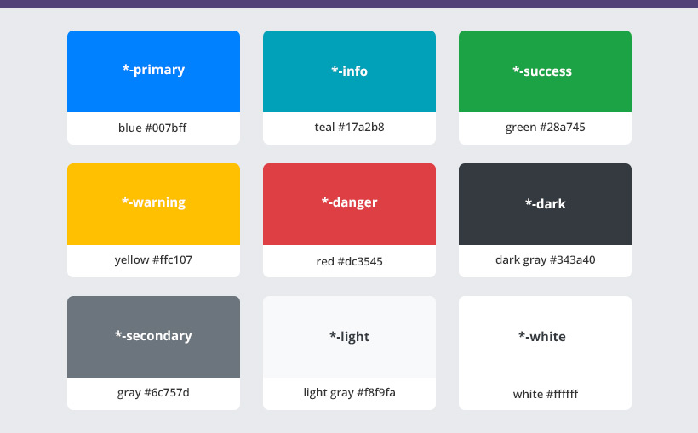
Bootstrap Color Palette

Slide 129
Example for Color Palette
<div class=”container”>
<div class=”rows”>
<div class=”col-lg-6 bg-primary”>
<p>Sample</p>
</div>
<div class=”col-lg-6 bg-info”>
<p>Sample</p>
</div>
</div>
</div>

Slide 130
Margin & Padding
We can have spacing between two elements with css box property
Margin- m,mt,mb,ml,mr
Margin – Spacer – m-auto,ml-auto,mr-auto (Size vary from 0-5)
Padding – p,pt,pb,pl,pr

Slide 131
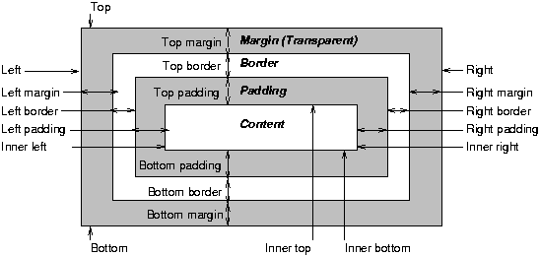

Slide 132
Bootstrap Navbar
Bootstarp Components – Navbar
HTML Elements – Block-level Elements, Inline Elements
CSS Box Properties

Slide 133
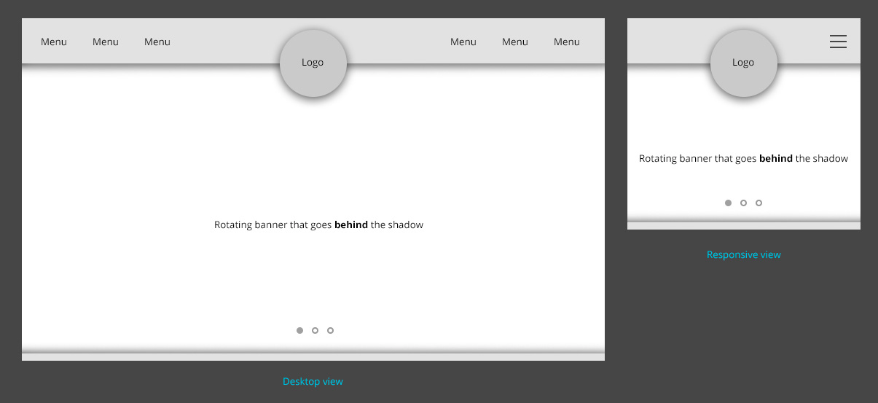

Slide 134
Bootstrap Navbar with brand and disable
<nav class="navbar navbar-expand-lg navbar-light bg-light">
<a class="navbar-brand" href="#">
<img src="https://placeholder.pics/svg/150x50/888888/EEE/Logo" alt="..." height="36">
</a>
<button class="navbar-toggler" type="button" data-toggle="collapse" data-target="#navbarNav" aria-controls="navbarNav" aria-expanded="false" aria-label="Toggle navigation">
<span class="navbar-toggler-icon"></span>
</button>
<div class="collapse navbar-collapse" id="navbarNav">
<ul class="navbar-nav">
<li class="nav-item active">
<a class="nav-link" href="#">Home <span class="sr-only">(current)</span></a>
</li>
<li class="nav-item">
<a class="nav-link" href="#">Features</a>
</li>
<li class="nav-item">
<a class="nav-link" href="#">Pricing</a>
</li>
<li class="nav-item">
<a class="nav-link disabled" href="#">Disabled</a>
</li>
</ul>
</div>
</nav>

Slide 135
HTML BLOCK ELEMENTS
These Elements always start in a new line and take up the full width avaliable
Examples : h1 elements, p elements, div element
<h1 class=”s”>sample</h1>
.s{font-size:20px;}

Slide 136
HTML INLINE ELEMENTS
These elements does not start in a new line and only take ip as much width as necessary
Examples – Button, Image, Anchor
Anchor - <p>Sample1><a class=”link”>Sample</a></p>
.link{background-color:#036;color:#fff;text-decoration:none;}

Slide 137
CSS Selectors and Inheritance
1. CSS Selectors – Type Selectors, ID Selectors, Class Selectors
2. Most Fundamental Concepts of CSS - Inheritance

Slide 138
Selectors
Selectors are used to select HTML Element which we want to style. Different type of selector
Simple Selector
Class Selector (.)
ID Selector (#)
Type (tag name) Selector (p,h1,span)
Universal selector (p,h1,span)
Attribute Selector
Pseudo-class (Onhover,Onclick)
Compound Selector
Complex Selector

Slide 139
Fundamental Concepts of CSS
HTML Elements depend on three fundamental concpets
Inheritance
Specificy
cascade

Slide 140
Inheritance
Some of CSS Property values set on the Parent Element are received (Inherited) by their Child elements
<div class=”container”> -- Parent
<div class=”row”> -- Child
....
</div>
</div>
TWO TYPES :
1. Inherited Properties
2. Non-Inherited Properties

Slide 141
Inheritance Properties
If properties applied to the parent element are inherited by the child elements then they are called as inheriance properties
Examples :
1. color
2. text-align
3. font-family etc.,

Slide 142
Non - Inheritance Properties
If they don’t inherit. Then they are non-inheritance properties.
Examples :
1. width,height
2. border,padding and margin
3. background-image etc.,

Slide 143
Specificity
Specificity is a means by which browser decide the most relevant CSS property values for an element.
Examples :
<h1>...</h1> - h1{font-size:16px;color:grey;}
<h1>..</h1> - h1{font-size:16px;color:grey}
Class Selector : - Type to Class
<h2 class=”sample”>..</h2> - .sample{color:green}
Class & ID Selector : - Type to Class to ID
<h2 class=”sample” id=”sample”>..</h2> -
.sample{color:green} / #sample{font-weight:bold;}

Slide 144
Inline Style
Inline styles are applied directly to HTML Elements
They use the styke attribute with CSS Properties values defiend within it.
Specificity – Type to Class to ID to Inline Styles
Syntax :
<tag style=”property1:value1;property2:value2,..”>Sample</tag>
Example :
<h1 style=”font-size:15px;color:#036;”>Sample</h1>

Slide 145
Cascade
The source order of css rulesets matter
When two rulesets apply that have equal specificity the one that comes last in the css will be used.
Example
<h1>Sample</sample>
CSS :
h1{color:red;}
h1{color:green;}

Slide 146
Cascade (Class attributes)
Order to class name defined in the class.
Example
<h1 class=”s”>Sample</sample>
CSS :
.s{color:red;}
.s{color:green;}

Slide 147
A special piece of css used to make a particular property and value the most specific thing. Irrespective of source order and specificity.
When you want to override foregin css (from external libaries and frameworks like Bootstrap)
Example : -1
<h1 class=”sample”>Hai</h1>
.sample{color : green;}
h1{color: red !important}
Example : -2
<h1 class=”sample”>Hai</h1>
.sample{color : green !important;}
h1{color: red !important}
The !important Exception

Slide 148
CSS3 2D Transforms
2D Transformation of Elements
With CSS3 2D transform feature you can perform basic transform manipulations such as move, rotate, scale and skew on elements in a two-dimensional space.
A transformed element doesn't affect the surrounding elements, but can overlap them, just like the absolutely positioned elements. However, the transformed element still takes space in the layout at its default (un-transformed) location.
Using CSS Transform and Transform Functions
The CSS3 transform property uses the transform functions to manipulate the coordinate system used by an element in order to apply the transformation effect.
The following section describes these transform functions:

Slide 149
The translate() Function
Moves the element from its current position to a new position along the X and Y axes. This can be written as translate(tx, ty). If ty isn't specified, its value is assumed to be zero.
<!DOCTYPE html>
<html lang="en">
<head>
<meta charset="utf-8">
<title>Example of CSS3 translate() Method</title>
<style>
img {
-webkit-transform: translate(200px, 50px); /* Chrome, Safari, Opera */
-moz-transform: translate(200px, 50px); /* Firefox */
-ms-transform: translate(200px, 50px); /* IE 9 */
transform: translate(200px, 50px); /* Standard syntax */
}
.box{
margin: 50px;
width:153px;
height:103px;
background: url("/examples/images/tortoise-transparent.png") no-repeat;
}

Slide 150
</style>
</head>
<body>
<div class="box">
<img src="/examples/images/tortoise.png" alt="Tortoise">
</div>
</body>
</html>

Slide 151
The rotate() Function
The rotate() function rotates the element around its origin (as specified by the transform-origin property) by the specified angle. This can be written as rotate(a).
img { -webkit-transform: rotate(30deg); /* Chrome, Safari, Opera */
-moz-transform: rotate(30deg); /* Firefox */
-ms-transform: rotate(30deg); /* IE 9 */
transform: rotate(30deg); /* Standard syntax */ }

Slide 152
The scale() Function
The scale() function increases or decreases the size of the element. It can be written as scale(sx, sy). If sy isn't specified, it is assumed to be equal to sx.
img { -webkit-transform: scale(1.5); /* Chrome, Safari, Opera */
-moz-transform: scale(1.5); /* Firefox */
-ms-transform: scale(1.5); /* IE 9 */
transform: scale(1.5); /* Modern Browsers */ }

Slide 153
The skew() Function
The skew() function skews the element along the X and Y axes by the specified angles. It can be written as skew(ax, ay). If ay isn't specified, its value is assumed to be zero.
img {
-webkit-transform: skew(-40deg, 15deg); /* Chrome, Safari, Opera */
-moz-transform: skew(-40deg, 15deg); /* Firefox */
-ms-transform: skew(-40deg, 15deg); /* IE 9 */
transform: skew(-40deg, 15deg); /* Modern Browsers */
}

Slide 154
CSS3 Transitions
Understanding CSS3 Transitions
Normally when the value of a CSS property changes, the rendered result is instantly updated. A common example is changing the background color of a button on mouse hover. In a normal scenario the background color of the button is changes immediately from the old property value to the new property value when you place the cursor over the button.
CSS3 introduces a new transition feature that allows you to animate a property from the old value to the new value smoothly over time. The following example will show you how to animate the background-color of an HTML button on mouse hover.

Slide 155
<!DOCTYPE html>
<html lang="en">
<head>
<meta charset="utf-8">
<title>Example of CSS3 Transition</title>
<style>
button {
color: #fff;
border: none;
padding: 10px 20px;
font: bold 18px sans-serif;
background: #fd7c2a;
-webkit-transition: background 2s; /* For Safari 3.0 to 6.0 */
transition: background 2s; /* For modern browsers */
}
button:hover {
background: #3cc16e;
}
</style>
</head>
<body>
<button type="button">Hover on me</button>
</body>
</html>

Slide 156
<!DOCTYPE html>
<html lang="en">
<head>
<meta charset="utf-8">
<title>Example of CSS3 Transition</title>
<style>
button {
color: #fff;
border: none;
padding: 10px 20px;
font: bold 18px sans-serif;
background: #fd7c2a;
-webkit-transition: background 2s; /* For Safari 3.0 to 6.0 */
transition: background 2s; /* For modern browsers */
}
button:hover {
background: #3cc16e;
}
</style>
</head>
<body>
<button type="button">Hover on me</button>
</body>
</html>

Slide 157
Performing Multiple Transitions
Each of the transition properties can take more than one value, separated by commas, which provides an easy way to define multiple transitions at once with different settings.
<style>
button {
color: #fff;
padding: 10px 20px;
font: bold 18px sans-serif;
background: #fd7c2a;
border: 3px solid #dc5801;
/* For Safari 3.0+ */
-webkit-transition-property: background, border;
-webkit-transition-duration: 1s, 2s;
/* Standard syntax */
transition-property: background, border;
transition-duration: 1s, 2s;
}
button:hover {
background: #3cc16e;
border-color: #288049;
}
</style>

Slide 158
Creating CSS3 Animations
In the previous chapter you've seen how to do simple animations like animating a property from one value to another via CSS3 transitions feature. However, the CSS3 transitions provide little control on how the animation progresses over time.
The CSS3 animations take it a step further with keyframe-based animations that allow you to specify the changes in CSS properties over time as a set of keyframes, like flash animations. Creating CSS animations is a two step process, as shown in the example below:
The first step of building a CSS animation is to defining individual keyframes and naming an animation with a keyframes declaration.
The second step is referencing the keyframes by name using the animation-name property as well as adding animation-duration and other optional animation properties to control the animation's behavior.

Slide 159
<!DOCTYPE html>
<html lang="en">
<head>
<meta charset="utf-8">
<title>Example of CSS3 Translate Animation</title>
<style>
.box {
margin: 50px;
width:153px;
height:103px;
background: url("/examples/images/tortoise-transparent.png") no-repeat;
position: relative;
/* Chrome, Safari, Opera */
-webkit-animation-name: moveit;
-webkit-animation-duration: 2s;
/* Standard syntax */
animation-name: moveit;
animation-duration: 2s;
}

Slide 160
/* Chrome, Safari, Opera */
@-webkit-keyframes moveit {
from {left: 0;}
to {left: 50%;}
}
/* Standard syntax */
@keyframes moveit {
from {left: 0;}
to {left: 50%;}
}
</style>
</head>
<body>
<p><strong>Note:</strong> Click the "Show Output" button to repeat the animation.</p>
<div class="box"></div>
</body>
</html>

Slide 161
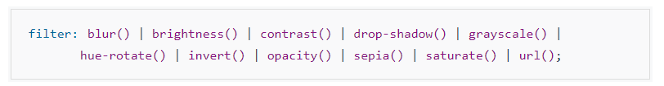
CSS3 Filters
Understanding the CSS3 Filter Functions
In this chapter we'll discuss about the filter effects introduced in CSS3 that you can use to perform visual effect operations like blur, balancing contrast or brightness, color saturation etc. on graphical elements like an image before it is drawn onto the web page.
The filter effects can be applied to the element using the CSS3 filter property, which accept one or more filter function in the order provided.

Slide 162
The Blur Effect
Photoshop like Gaussian blur effect can be applied to an element using the blur() function. This function accepts CSS length value as parameter which defines the blur radius. A larger value will create more blur. If no parameter is provided, then a value 0 is used.
<head>
<meta charset="utf-8">
<title>Example of CSS3 Blur Filter Effect</title>
<style>
img.blur {
-webkit-filter: blur(2px); /* Chrome, Safari, Opera */
filter: blur(2px);
}
img.extra-blur {
-webkit-filter: blur(5px); /* Chrome, Safari, Opera */
filter: blur(5px);
}
/* Some CSS to beautify this example */
table td{
padding: 10px;
text-align: center;
}
</style>
</head>

Slide 163
<body>
<table>
<tr>
<td>
<img src="/examples/images/parrot.png" alt="Parrot">
</td>
<td>
<img class="blur" src="/examples/images/parrot.png" alt="Parrot">
</td>
<td>
<img class="extra-blur" src="/examples/images/parrot.png" alt="Parrot">
</td>
</tr>
<tr>
<td>Original Image</td>
<td>blur(2px)</td>
<td>blur(5px)</td>
</tr>
</table>
</body>
</html>

Slide 164
Setting the Image Brightness
The brightness() function can be used to set the brightness of an image. A value of 0% will create an image that is completely black. Whereas, a value of 100% or 1 leaves the images unchanged. Other values are linear multipliers on the effect.
You can also set the brightness higher than the 100% which results in brighter image. If the amount parameter is missing, a value of 1 is used. Negative values are not allowed.
img.bright {
-webkit-filter: brightness(200%); /* Chrome, Safari, Opera */
filter: brightness(200%);
}
img.dark {
-webkit-filter: brightness(50%); /* Chrome, Safari, Opera */
filter: brightness(50%); }

Slide 165
Adjusting the Image Contrast
The contrast() function is used to adjust the contrast on an image. A value of 0% will create an image that is completely black. Whereas, a value of 100% or 1 leaves the image unchanged. Values over 100% are also allowed which provide results with less contrast. If the amount parameter is missing or omitted, a value of 1 is used.
img.bright
{
-webkit-filter: contrast(200%); /* Chrome, Safari, Opera */
filter: contrast(200%);
}
img.dim {
-webkit-filter: contrast(50%); /* Chrome, Safari, Opera */
filter: contrast(50%);
}

Slide 166
Adding Drop Shadow to Images
You can use the drop-shadow() function to apply the drop shadow effect to the images like Photoshop. This function is similar to the box-shadow property.
img {
-webkit-filter: drop-shadow(4px 4px 10px orange); /* Chrome, Safari, Opera */
filter: drop-shadow(4px 4px 10px orange);
}

Slide 167
Converting an Image to Grayscale
The images can be converted to grayscale using the grayscale() function. A value of 100% is completely grayscale. A value of 0% leaves the image unchanged. Values between 0% and 100% are linear multipliers on the effect. If the amount parameter is missing, a value of 0 is used.
<style>
img.complete-gray {
-webkit-filter: grayscale(100%); /* Chrome, Safari, Opera */
filter: grayscale(100%);
}
img.partial-gray {
-webkit-filter: grayscale(50%); /* Chrome, Safari, Opera */
filter: grayscale(50%);
}
/* Some CSS to beautify this example */
table td{
padding: 10px;
text-align: center;
}
</style>

Slide 168
The Invert Effect
The invert effect like Photoshop can be applied to an image with the invert() function. A value of 100% or 1 is completely inverted. A value of 0% leaves the input unchanged. Values between 0% and 100% are linear multipliers on the effect. If the 'amount' parameter is missing, a value of 0 is used. Negative values are not allowed.
<style>
img.partially-inverted {
-webkit-filter: invert(80%); /* Chrome, Safari, Opera */
filter: invert(80%);
}
img.fully-inverted {
-webkit-filter: invert(100%); /* Chrome, Safari, Opera */
filter: invert(100%);
}
/* Some CSS to beautify this example */
table td{
padding: 10px;
text-align: center;
}
</style>

